Slide 1

Basement Impact on House Prices
Christiana Kim

Slide 2
Objective
Determine factors that drive house sale prices
Understand how to allocate investments into mortgage-backed securities

Slide 3
Data Overview
Sample of 1460 houses
2006-2010
Data source: Kaggle
https://www.kaggle.com/c/house-prices-advanced-regression-techniques/data

Slide 4
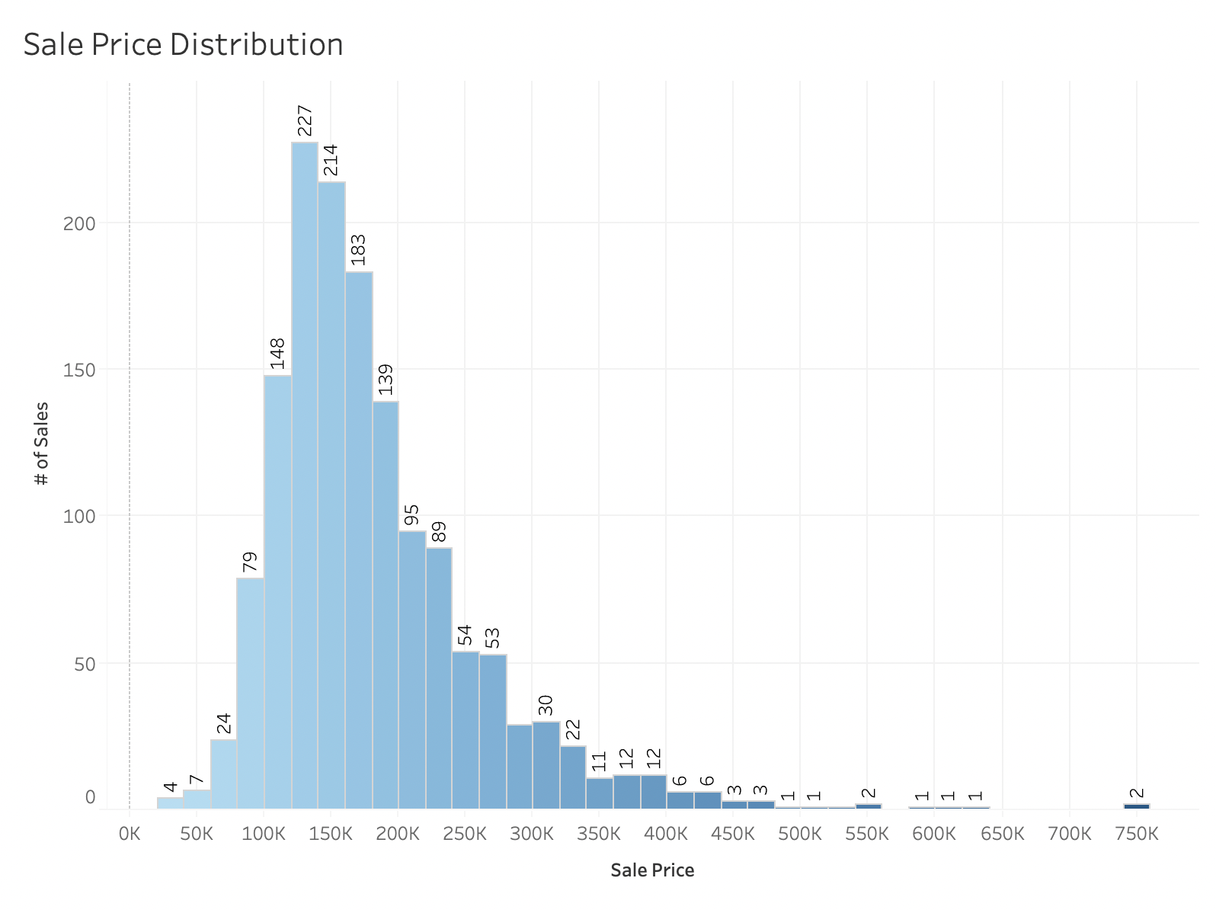
Descriptive Statistics
Normally distributed & unbiased
Mean: $180,921
Median: $163,000
Mode: $140,000
Min: $34,900
Max: $755,000
Count: 1460 sales

Slide 5
Do basements drive sale price?
Basement vs. No Basement
Exposure vs. Minimum to No Exposure
Refers to walkout or garden level walls
Finished vs. Unfinished

Slide 6
Basement
H₀: µ₁ - µ₂ = 0
Hₐ: µ₁ - µ₂ ≠ 0
Reject null hypothesis
p < 0.05
With 95% confidence, the difference in means between homes with basements vs. no basement is between $66,679 and $87,772.

Slide 7
Basement Exposure
H₀: µ₁ - µ₂ = 0
Hₐ: µ₁ - µ₂ ≠ 0
Reject null hypothesis
p < 0.05
With 95% confidence, the difference in means between basements with good or average exposure vs. minimum to no exposure is between $45,867 and $68,853.

Slide 8
Finished Basement
H₀: µ₁ - µ₂ = 0
Hₐ: µ₁ - µ₂ ≠ 0
Reject null hypothesis
p = 0.001
With 95% confidence, the difference in means between finished basements vs. unfinished is between $4,191 and $20,225.

Slide 9
Conclusion & Recommendations
Basements have a statistically significant impact on sale price
Factors to look for when investing in a house:
House has a basement
Basement has exposure
Basement is finished

Slide 10

Questions?

